Slide 1
Instruction and Instruction Sequencing
Carl Hamacher, Zvonko Vranesic and Safwat Zaky, Computer Organization and Embedded Systems, (6e), McGraw Hill Publication, 2017.

Slide 2
Instruction and Instruction Sequencing
The tasks carried out by a computer program consist of a sequence of small steps, such
as adding two numbers, testing for a particular condition, reading a character from the
keyboard, or sending a character to be displayed on a display screen.
A computer must have instructions capable of performing four types of operations:
“Must-Perform” Operations:-
  Data transfers between the memory and the processor registers
  Arithmetic and logic operations on data
  Program sequencing and control
  I/O transfers

Slide 3
Instruction and Instruction Sequencing
1. Data transfers between memory and processor registers
Purpose: Move data around inside the system.
Examples:
  Load data from memory into a CPU register.
  Store data from a CPU register back to memory.
  Transfer data between registers.
Why needed: The CPU cannot directly perform arithmetic on memory; it must first bring the data into registers.

Slide 4
Instruction and Instruction Sequencing
2. Arithmetic and logic operations on data
Purpose: Perform computations and decision-making.
Arithmetic operations: addition, subtraction, multiplication, division.
Logic operations: AND, OR, NOT, XOR, shifts, comparisons.
Example:
  R1 ← R2 + R3 (add contents of R2 and R3, store in R1).
  if (R1 > R2) → set a flag for branching.
Why needed: To process information, solve problems, and make decisions

Slide 5
Instruction and Instruction Sequencing
3. Program sequencing and control
Purpose: Decide the order in which instructions are executed.
Includes:
  Branching / Jumping: Change the flow of execution (if, else, goto, for loops).
  Subroutine calls and returns: Modular programming, reuse of code.
Example:
  If a condition flag is true, jump to a new instruction address.
Why needed: Programs are not always linear; decisions and loops require control.

Slide 6
Instruction and Instruction Sequencing
4. I/O transfers
Purpose: Communicate with the outside world (input/output devices).
Types:
  Input: Transfer data from keyboard, disk, sensor → into memory/registers.
  Output: Transfer data from memory/registers → to screen, printer, or network.
Why needed: A computer is useless without interacting with users or external devices

Slide 7
Register Transfer Notation
Identify a location by a symbolic name standing for its hardware binary address (LOC, R0,…)
Contents of a location are denoted by placing square brackets around the name of the location
e.g. R1←[LOC]
R3 ←[R1]+[R2]
This type of notation is Register Transfer Notation (RTN)

Slide 8
Assembly-Language Notation
Instead of writing binary (10110000 01100001), we use mnemonics (like MOV A, 61h).
It is machine-dependent (specific to each processor architecture).
Represent machine instructions and programs.
Move R1,LOC → R1←[LOC]
Add R3, R1, R2 → R3 ←[R1]+[R2]

Slide 9
🔹 Example (x86 Assembly)
START: MOV AX, 5 ; Move value 5 into register AX
ADD AX, 3 ; Add 3 to AX
MOV BX, AX ; Copy result into BX
JMP START ; Jump back to label START
MOV = move data
ADD = add numbers
JMP = jump instruction

Slide 10
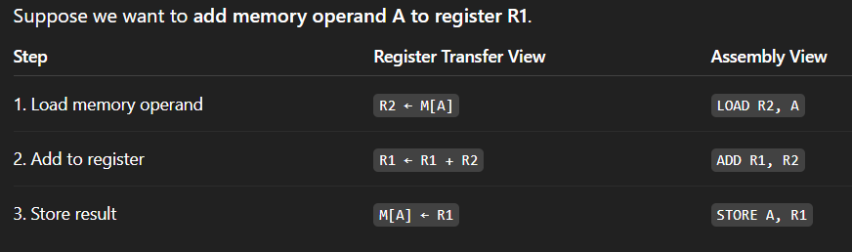
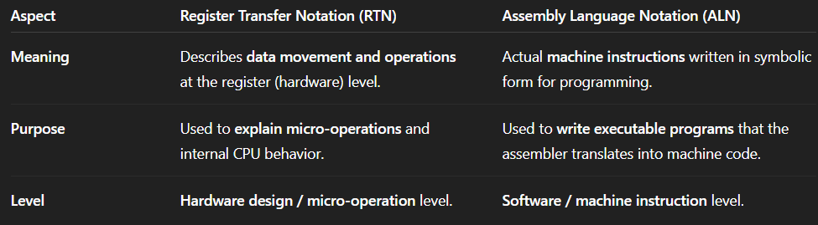

Slide 11
RISC and CISC Instruction Set
Most important characteristics that distinguish different computers is the
NATURE OF THEIR INSTRUCTIONS:-
1. CISC (Complex Instruction Set Computer)
Philosophy: “Hardware should do more.”
Focuses on having many complex instructions, some of which can perform multi-step operations in a single instruction.
Instructions may vary in length and take multiple cycles to execute.
✅ Features:
Large instruction set (hundreds of instructions).
Instructions can access memory directly (like ADD A, [1000]).
Complex instructions may take multiple clock cycles.
Uses fewer lines of assembly code (since one instruction can do a lot).
More hardware complexity, less compiler dependency.

Slide 12
RISC and CISC Instruction Set
Most important characteristics that distinguish different computers is the nature of their instructions
CISC (Complex Instruction Set Computer)
MULT R1, R2, R3
This could multiply values in R2 and R3, and store result in R1 in one instruction.
Examples of CISC processors: Intel x86, VAX, IBM 370.

Slide 13
RISC and CISC Instruction Set
RISC (Reduced Instruction Set Computer)
Philosophy: “Software should do more, hardware should be simple and fast.”
Focuses on a small set of simple instructions that execute in one clock cycle.
More instructions are needed to perform the same task, but each is executed very quickly.
✅ Features:
Small instruction set (a few dozen to a hundred).
All instructions are of fixed length (easy for pipelining).
Most instructions operate on registers (Load/Store architecture).
Executes in a single clock cycle (mostly).
More compiler optimization, less hardware complexity.

Slide 14
RISC and CISC Instruction Set
RISC (Reduced Instruction Set Computer)
Example:
To multiply two numbers:
LOAD R1, A
LOAD R2, B
MUL R3, R1, R2
STORE R3, C
Takes more lines than CISC, but each instruction is simple and fast.
Examples of RISC processors: ARM, MIPS, SPARC, RISC-V.

Slide 15
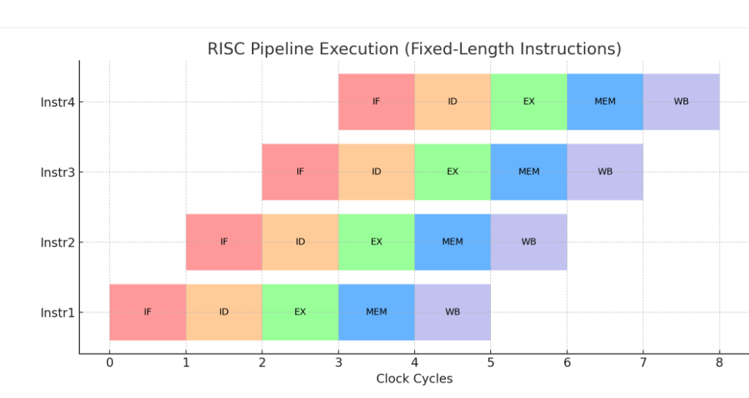

Slide 16
Key Differences (Quick Table)
Feature | CISC | RISC
Instruction set | Large & complex | Small & simple
Instruction size | Variable | Fixed
Execution cycles | Many per instruction | Mostly single-cycle
Memory access | Many instructions access mem | Only load/store access mem
Hardware | Complex (microcode) | Simple (hardwired control)
Code size | Smaller (fewer lines) | Larger (more instructions)
Used in | x86 (Intel/AMD PCs) | ARM (mobiles), RISC-V, MIPS

Slide 17
CISC (Complex Instruction Set Computer)
Where used:
  Personal computers (PCs)
  Laptops
  Servers
Most desktop processors today (Intel x86 and AMD) are based on CISC architecture.
🔹 RISC (Reduced Instruction Set Computer)
Where used:
  Smartphones (ARM processors in almost all Android/iOS devices)
  Tablets
  Embedded systems (IoT, automotive, routers, etc.)
  High-performance computing (many modern supercomputers use RISC-based chips like RISC-V or POWER).

Slide 18
RISC Instruction Sets
C = A + B
C ← [A] + [B]
Assembly:
  Load R2, A
  Load R3, B
  Add R4, R2, R3
  Store R4, C
Three-Address Instructions
  Add destination, source1, source2
The Store instruction is of the form
  Store source, destination

Slide 19
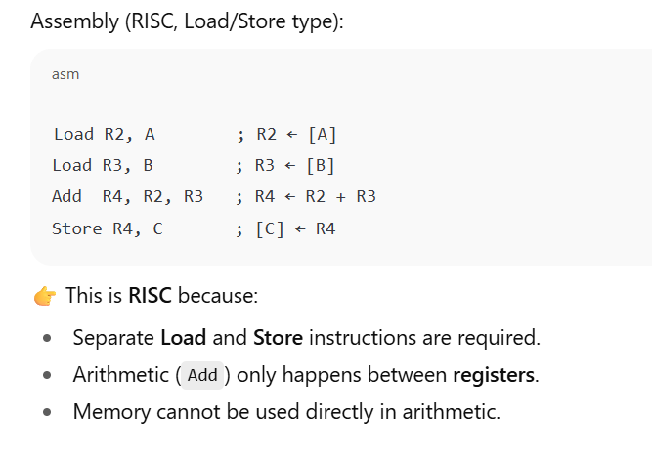

Slide 20
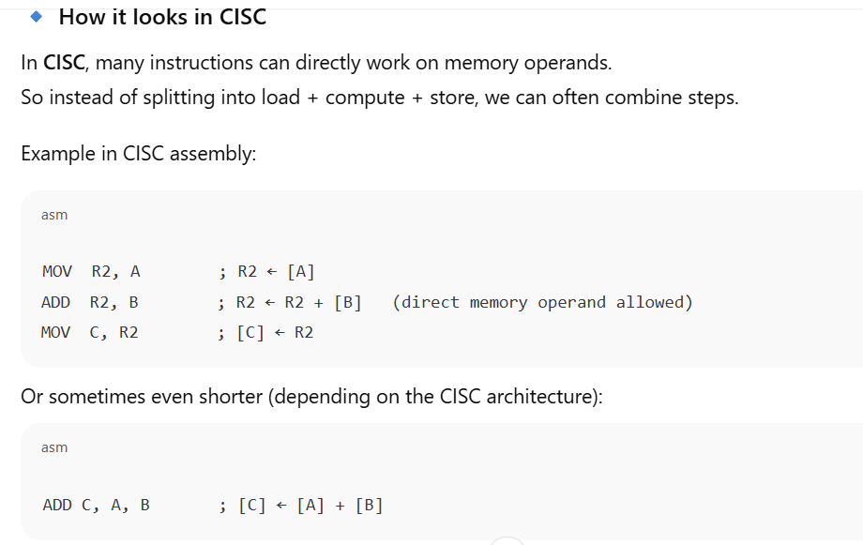

Slide 21
Differences:
In CISC, the ADD instruction can take memory operands directly.
You don’t always need a separate Load and Store for each variable.
Instructions are more complex and may take multiple cycles to execute.

Slide 22
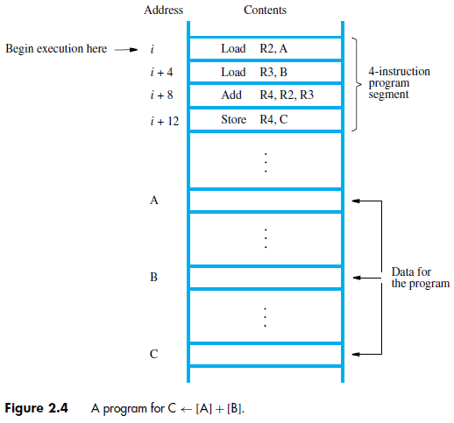
Instruction Execution and Straight-Line Sequencing
a possible program segment for the task, C=A+B, as it appears in the memory of a computer.
Straight-line sequencing: using the information in the PC to fetch and execute instructions, one at a time, in the order of increasing addresses.
Executing a given instruction is a two-phase procedure.
  Instruction fetch (First phase)
  Instruction execute (Second phase)

Slide 23
Two-Phase Execution of Each Instruction
Every instruction goes through two fundamental phases:
Instruction Fetch (IF)
  The instruction is fetched from memory.
  PC gives the memory address of the instruction.
  The instruction is placed into the Instruction Register (IR).
  PC is updated to the next instruction.
Instruction Execute (EX)
  The instruction in IR(Inst. Reg.) is decoded and executed.
  Example: if it’s ADD R4, R2, R3, the ALU performs addition.
  If it’s LOAD, data is moved from memory to a register.
  If its STORE , data is moved from register to memory

Slide 24
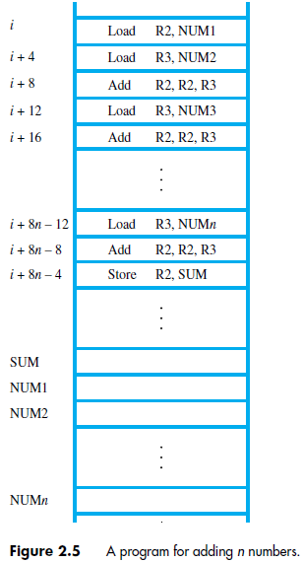
Branching
Consider the task of adding a list of n numbers.

Slide 25
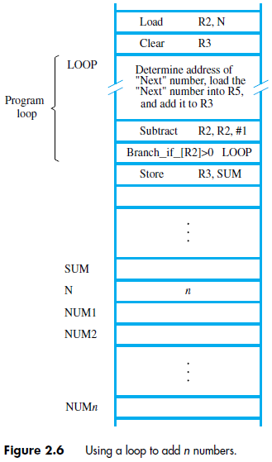
Branching
Consider the task of adding a list of n numbers in a loop.

Slide 26
Generating Memory Addresses
The purpose of the instruction block starting at LOOP is to add successive numbers from the list during each pass through the loop
must refer to a different address during each pass
memory operand address cannot be given directly in a single Load instruction in the loop.

Slide 27
